Slide 1


23rd January 2022
Assignment 2:
POG & PESTLE
Peeko
A Digital Service by Chirag Huria

Slide 2

peeko.
Unlocking the wisdom of crowds
Peek. Speak. Repeat.
Notes:
The black and white landscapes of an introvert, a shy speaker, a lost professional, and an idle mind need to be illuminated with the colors of hope, and the wisdom of crowds
Networking has become an inherent part of our lives. Humans thrive and learn through conversations. …and a conversation is much more significant than what a Tweet or Instagram post can capture. A conversation is about the emotion, the body language, and the relationships we form through meaningful interactions.
The pandemic has furthermore accentuated and has yet again reminded us the importance of physical connections.
It is all about hearing and sharing the stories and experiences and growing together IN THE REAL WORLD.
Let say, I have 2 hours of free time between my classes, I don’t know what to do. I would love to hear and learn from a peer, but I don’t know who is interested in what.
We introduce to you, PEEKO – a one-stop platform that leverages the power of technology to map your areas of interest, to find like-minded individuals in your neighborhood, and facilitate meaningful dialogues that add value.

Slide 3

Our Mission
Building real-world knowledge communities by personalizing everyday conversations
Notes:
Our mission is to leverage these physical connections, and build communities of folks with similar interests. At Peeko, we envision to build

Slide 4
Why are conversations not happening?
Do you find it easy to begin conversations with everyone in-person?
Do you think physical interactions are replaceable?
Do you know the interest areas of potentially everyone you meet?
Sources available in Appendix

Slide 5
Why are conversations not happening?
If your response was a NO…
A GAP HAS BEEN FOUND.
Come unlock the wisdom of crowds with Peeko – personalizing everyday conversations!
Sources available in Appendix

Slide 6

Problem – Psychological Science POV
Pluralistic Ignorance Everyone is willing to talk but thinks everyone else is unwilling.
Psychological Experiment, The Cut
Sources available in Appendix
Notes:
Our problem is more pronounced than what it seems.
The number of unproductive hours that we spend each day can drastically be improved and channelized into time we spend on learning from our peers. It is often underestimated how much we can learn from our peers and surroundings.
But is it really that easy?
A psychological experiment in America’s unhappiest city, NewYork, in 2014 by University of Chicago concluded that social connection is essential for happiness and New York will be a happier city if they stepped out of their invisible bubble.
Two groups of people were made to travel on a bus. Half of them were asked to talk to the person next to them, and the other half to remain in their usual solitude. A survey was then sent out and as reported by the people who talked on their journey, they not just had a better travel experience but some also reported that it was intellectually enriching.
They pondered upon why at the first place were people not talking then?
PLURALISTIC IGNORANCE.
Read slide. Vicious circle!!

Slide 7


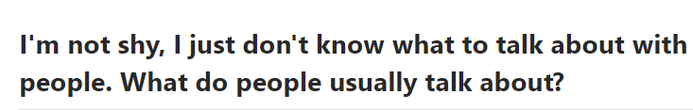
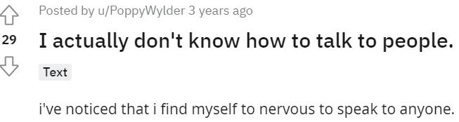
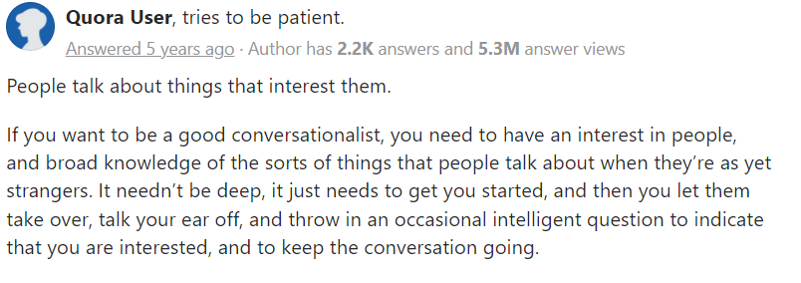
Problem – Users POV
People don’t know who is interested in what or how to go about having a conversation
Sources available in Appendix
Notes:
Our problem is more pronounced than what it seems.
The number of unproductive hours that we spend each day can drastically be improved and channelized into time we spend on learning from our peers. It is often underestimated how much we can learn from our peers and surroundings.
But is it really that easy?
A psychological experiment in America’s unhappiest city, NewYork, in 2014 by University of Chicago concluded that social connection is essential for happiness and New York will be a happier city if they stepped out of their invisible bubble.
Two groups of people were made to travel on a bus. Half of them were asked to talk to the person next to them, and the other half to remain in their usual solitude. A survey was then sent out and as reported by the people who talked on their journey, they not just had a better travel experience but some also reported that it was intellectually enriching.
They pondered upon why at the first place were people not talking then?
PLURALISTIC IGNORANCE.
Read slide. Vicious circle!!

Slide 8
PESTLE Analysis
Political
No large gatherings in the initial phase post-COVID
Economic
Increased investment in mental health and talent by companies
Social tech can boost productivity by 25%, McKinsey Study
Interest-based communities have a large market; Meetup has ~49M active users
Social
More than 5 hours spent each day doing nothing by an average American, CDC
26% millennials do not know their neighbour's first name, OnePoll Study
Increased frustration by staying indoors during COVID-19
Most people don’t know who has a shared interest as them
Less interactions because internet has consumed humans which is otherwise a social species
Technological
Increased investment in location satellites has improved location accuracy
Increased network usage, speed, connectivity, and reliability
Legal
Labor laws to improve work-life balance, Source
Environmental
COVID-19 has severly impacted mental health
Sources available in Appendix
Notes:
Our problem is more pronounced than what it seems.
The number of unproductive hours that we spend each day can drastically be improved and channelized into time we spend on learning from our peers. It is often underestimated how much we can learn from our peers and surroundings.
But is it really that easy?
A psychological experiment in America’s unhappiest city, NewYork, in 2014 by University of Chicago concluded that social connection is essential for happiness and New York will be a happier city if they stepped out of their invisible bubble.
Two groups of people were made to travel on a bus. Half of them were asked to talk to the person next to them, and the other half to remain in their usual solitude. A survey was then sent out and as reported by the people who talked on their journey, they not just had a better travel experience but some also reported that it was intellectually enriching.
They pondered upon why at the first place were people not talking then?
PLURALISTIC IGNORANCE.
Read slide. Vicious circle!!

Slide 9





Key Points from PESTLE
The Average American 5 hours spent each day doing nothing
The Working Professional 55 minutes spent travelling each day
The Millennial 26% do not know their neighbour's first name
CDC²
census.gov³
OnePoll Study⁴
The Disconnected Workspace Social Tech can boost productivity by 25%
The Chasing Loneliness 37% of meals consumed alone not by choice
McKinsey Study⁵
Forbes⁶
Sources available in Appendix
Notes:
Speaking about a few of these focus areas. A working professional spends a lot of time travelling, and then in many individual contributing roles spends time eating lunch alone. 37% of meals consumed alone are not by choice as reported by Forbes. These lunches could instead add value and may even become a fruitful deal. Fun fact: The 3.5bn$ merger between two Home Improvement giants - Black & Decker and Stanley Works happened over lunch in 2009.
The problem gets more pronounced in the younger demographic. The millennials are glued to their screens, and hardly step out. A study concludes that about 26% don’t know their neighbours, let alone learn from them. Imagine the value we can bring in the community if these strangers could become peers, and these peers become into communities of like-minded individuals that learn and grow together.

Slide 10
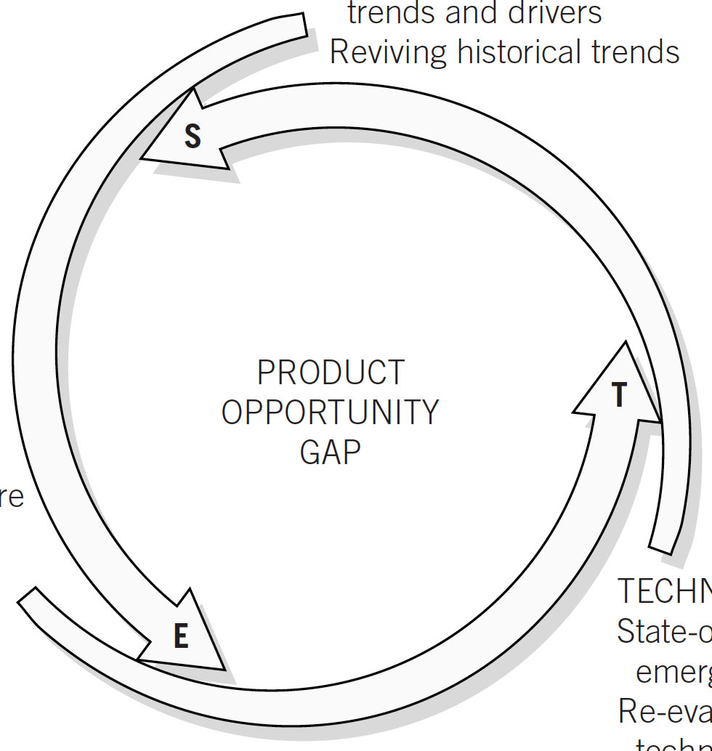
Product Opportunity Gap
Increase in awareness of internet’s impact on mental health, cases of social anxiety and importance of human interactions, especially post-COVID.
Employ user’s area of interest and location to facilitate real-world conversations and build communities
More investment on mental health by individuals and workforce technologies to organize knowledge communities
Pervasiveness of smartphones, reliable network connectivity and access to accurate location data of consumers
Sources available in Appendix
Notes:
Our problem is more pronounced than what it seems.
The number of unproductive hours that we spend each day can drastically be improved and channelized into time we spend on learning from our peers. It is often underestimated how much we can learn from our peers and surroundings.
But is it really that easy?
A psychological experiment in America’s unhappiest city, NewYork, in 2014 by University of Chicago concluded that social connection is essential for happiness and New York will be a happier city if they stepped out of their invisible bubble.
Two groups of people were made to travel on a bus. Half of them were asked to talk to the person next to them, and the other half to remain in their usual solitude. A survey was then sent out and as reported by the people who talked on their journey, they not just had a better travel experience but some also reported that it was intellectually enriching.
They pondered upon why at the first place were people not talking then?
PLURALISTIC IGNORANCE.
Read slide. Vicious circle!!

Slide 11




Our Solution - MVP
Personalizing everyday conversations and making it accessible for all personality types
You share your interests.
All through our app.
We connect the conversation.
Notes:
Our solution takes in your interests, helps you create a bio in our app. The app then leverages your location, and helps you locate folks with similar interests around you to connect and initiate a dialogue.
Going back to my personal example of having 2 hours between my classes. Through this app, let say if I am good with technology studying at Heinz, but I am curious to learn a bit more about the Product Management industry perhaps from someone taking a class at Tepper. The app would use my location at Heinz, and look for matches with Product as their interest areas and help me locate people around with an interest in Product who are available to talk.
I can then perhaps talk to someone with a Product experience, and use my 2 hours to actually form a real connection and get started into the Product industry

Slide 12

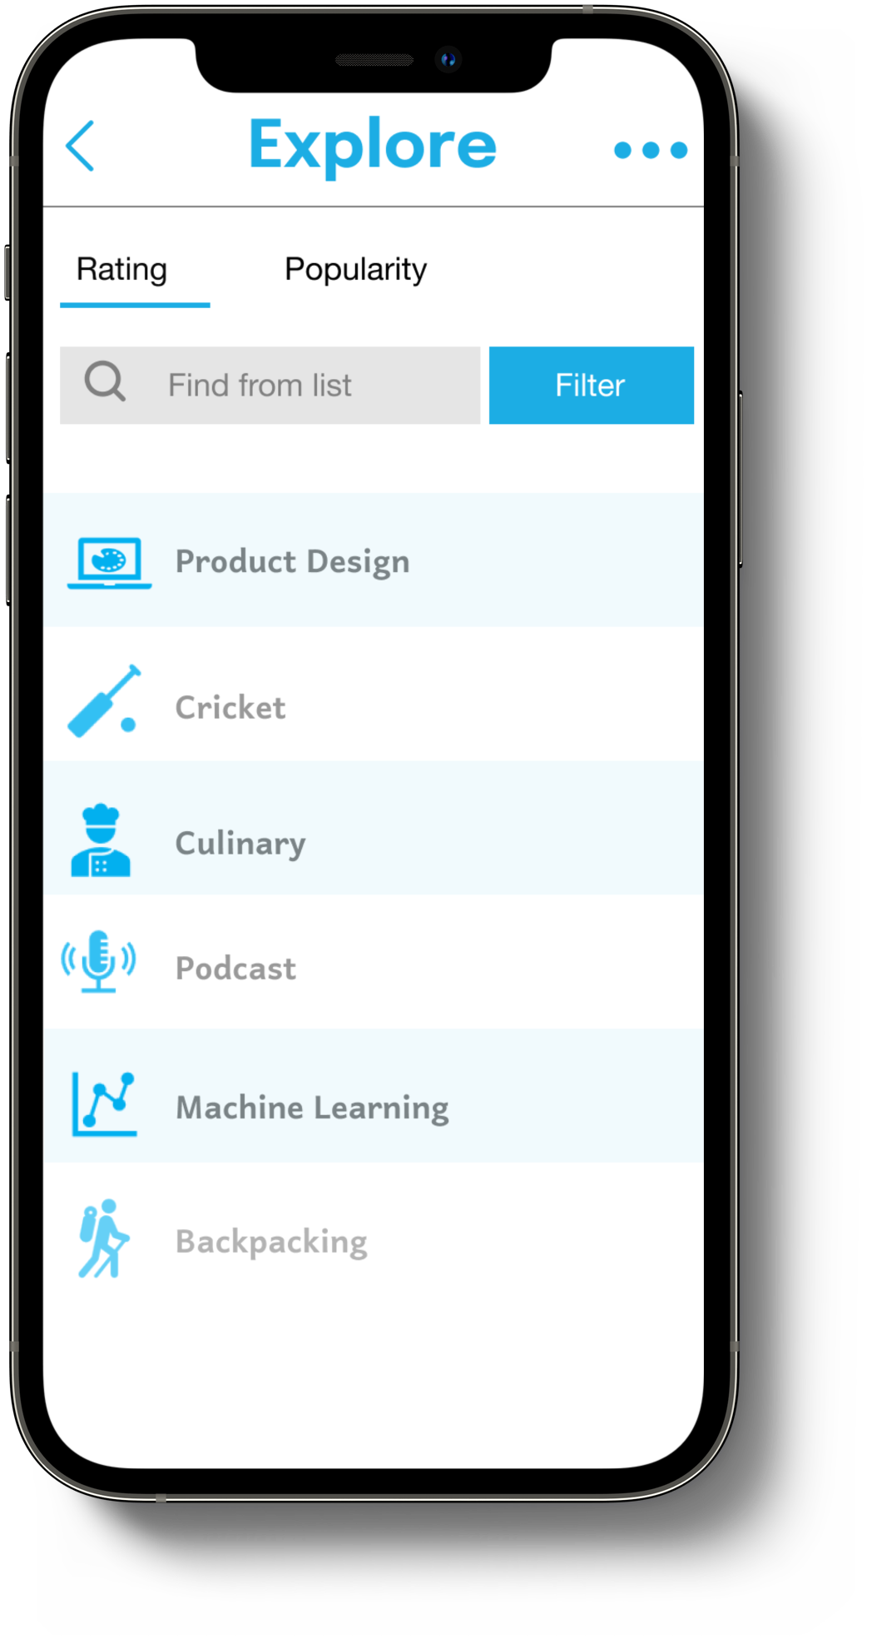
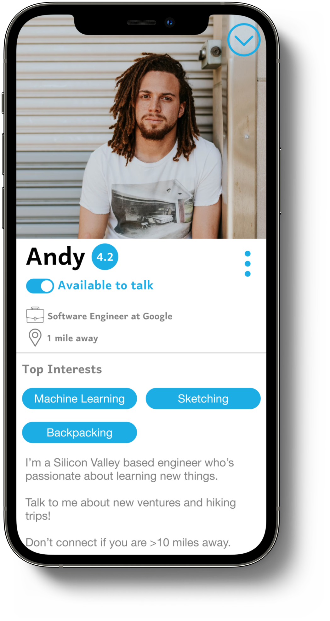
Sneak Peek
Home
Explore an area of interest
Build your profile
Notes:
Sneak peek. MACHINE LEARNING INTEREST AREA
If Andy goes ahead and talks

Slide 13
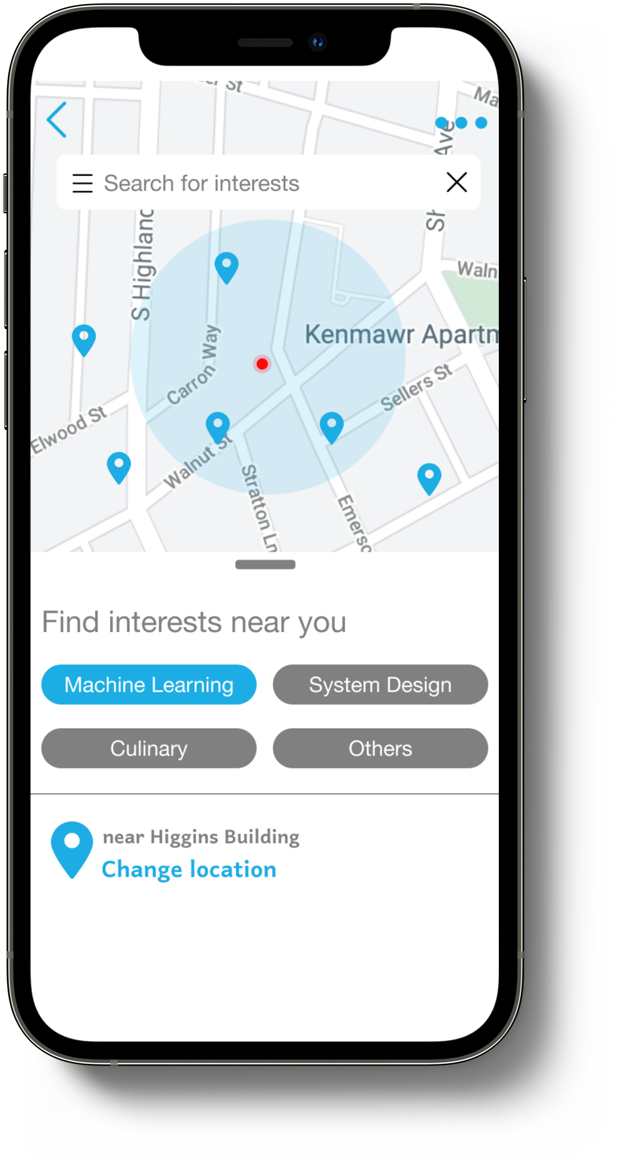
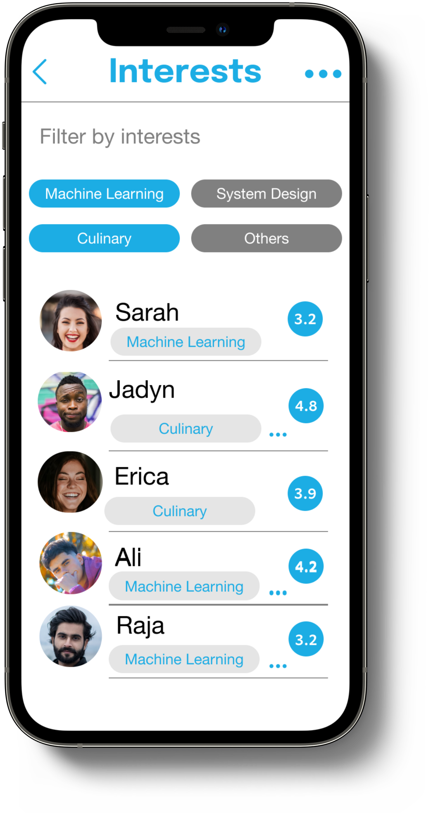
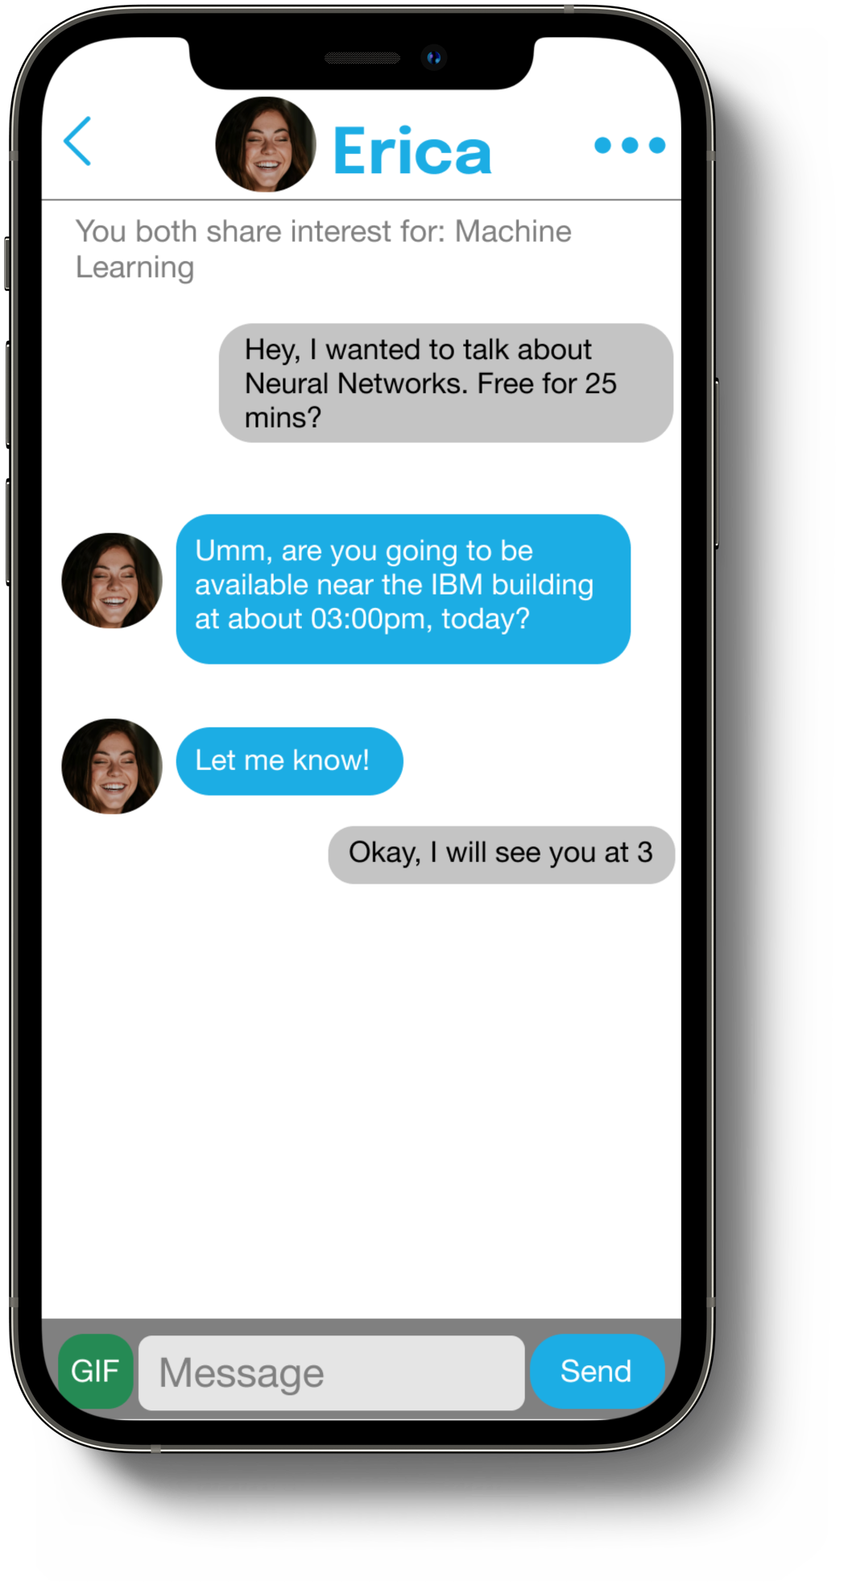
Sneak Peek
Locate an interest match around you
Explore users with similar interest
Chat and schedule a meetup
Notes:
Let say Sarah, and then perhaps a week later Sarah talks Erica, then we slowly start to build a community. After each successful conversation, the users can endorse eachother much like LinkedIn, but not superficial since it is based on real conversations. Like Facebook, the community will start building. Andy will be able to see Erica as a mutual since he spoke to the middle node – Sarah, and the circle of machine learners in the area would start coming up

Slide 14

Persona
“Learning through experiences is the quickest form of learning”
Christopher Noman
Personality
Frustration
I don’t usually know who to go and talk to during my free-time, and I end up wasting more time than I should
Introvert
Extrovert
Initiator
Follower
Challenge
I cannot sit in front of my screen for hours making virtual friends. I don’t know who around me has the same interest as mine
Creative
Logic
Age
26
Location
Houston
Accepting
Curious
Education
BS
Motivation
Job
Student
Goals
I want to talk to people, learn from their experiences, voice my opinion, nurture my interest, and grow as an expert
Bio
Build sustained relationships with people, learn from their stories, and enhance knowledge to make friends that can mentor and help grow
Chris is a student at a university and loves talking and learning from new people who share the same interest
Sources available in Appendix
Notes:
Our problem is more pronounced than what it seems.
The number of unproductive hours that we spend each day can drastically be improved and channelized into time we spend on learning from our peers. It is often underestimated how much we can learn from our peers and surroundings.
But is it really that easy?
A psychological experiment in America’s unhappiest city, NewYork, in 2014 by University of Chicago concluded that social connection is essential for happiness and New York will be a happier city if they stepped out of their invisible bubble.
Two groups of people were made to travel on a bus. Half of them were asked to talk to the person next to them, and the other half to remain in their usual solitude. A survey was then sent out and as reported by the people who talked on their journey, they not just had a better travel experience but some also reported that it was intellectually enriching.
They pondered upon why at the first place were people not talking then?
PLURALISTIC IGNORANCE.
Read slide. Vicious circle!!

Slide 15
Value Flow
Maps user interest to other users
Peeko
(Service Provider)
Conversations
User
User interest data
Subscription Fee
Enterprise
Improving talent-employee relationships
Networking within the organization
Notes:
Our problem is more pronounced than what it seems.
The number of unproductive hours that we spend each day can drastically be improved and channelized into time we spend on learning from our peers. It is often underestimated how much we can learn from our peers and surroundings.
But is it really that easy?
A psychological experiment in America’s unhappiest city, NewYork, in 2014 by University of Chicago concluded that social connection is essential for happiness and New York will be a happier city if they stepped out of their invisible bubble.
Two groups of people were made to travel on a bus. Half of them were asked to talk to the person next to them, and the other half to remain in their usual solitude. A survey was then sent out and as reported by the people who talked on their journey, they not just had a better travel experience but some also reported that it was intellectually enriching.
They pondered upon why at the first place were people not talking then?
PLURALISTIC IGNORANCE.
Read slide. Vicious circle!!

Slide 16





Our Differentiators
Our predecessors have done good work too… Peeko = Good parts of LinkedIn, Meetup, Facebook + Solutions to problems they have
What are they lacking?
Superficial Endorsements
Lack of quality connections and knowledge
Flexible, instant, 1-1 connections; introvert and social anxiety friendly
Economical meetups with low-overhead to organize them
Real-world connections based on location
Conversation-driven communities rather than content
Notes:
Finally, here’s our competition and our key differentiator.

Slide 17
Potential Market Size and Revenue
~15 Million Users
$150k
Annual AdSense Revenue
~900K Monthly Views
49 Million Users⁷ 2.87 Monthly Views⁷
~30% of Current Market
(5 Year Target)
Sources available in Appendix
Notes:
Meetup being the closest competitor of interest based connects, we aim to begin running our pilot from few cities which are either college or corporate hubs since they are the ones who are looking forward to network the most.
As the economics of the network effect plays out, we aim to scale in the next 5 years

Slide 18
Appendix
https://www.thecut.com/2014/07/why-new-yorkers-should-small-talk-more.html
https://www.cdc.gov/pcd/issues/2019/19_0017.htm
https://www.census.gov/newsroom/press-releases/2021/one-way-travel-time-to-work-rises.html
https://www.studyfinds.org/sign-of-the-times-75-of-adults-arent-friends-with-any-of-their-neighbors/
https://www.mckinsey.com/industries/technology-media-and-telecommunications/our-insights/the-social-economy
https://www.forbes.com/sites/thehartmangroup/2016/05/25/table-for-one-why-we-are-increasingly-eating-alone/?sh=539771b9616fhttps://www.cdc.gov/pcd/issues/2019/19_0017.htm
https://www.studyfinds.org/sign-of-the-times-75-of-adults-arent-friends-with-any-of-their-neighbors/
https://www.mckinsey.com/industries/technology-media-and-telecommunications/our-insights/the-social-economy
https://www.forbes.com/sites/thehartmangroup/2016/05/25/table-for-one-why-we-are-increasingly-eating-alone/?sh=539771b9616f
https://www.census.gov/newsroom/press-releases/2021/one-way-travel-time-to-work-rises.html
https://www.thecut.com/2014/07/why-new-yorkers-should-small-talk-more.html

Slide 19
peeko.
Unlocking the wisdom of crowds
Thank you

